Slide 1
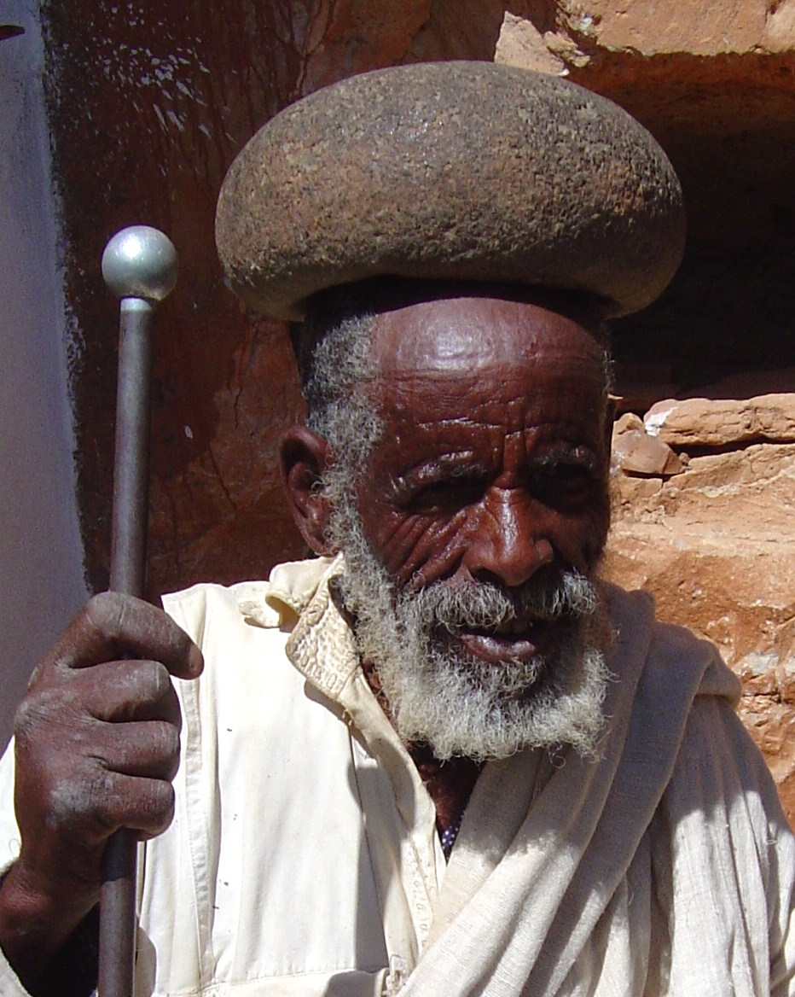
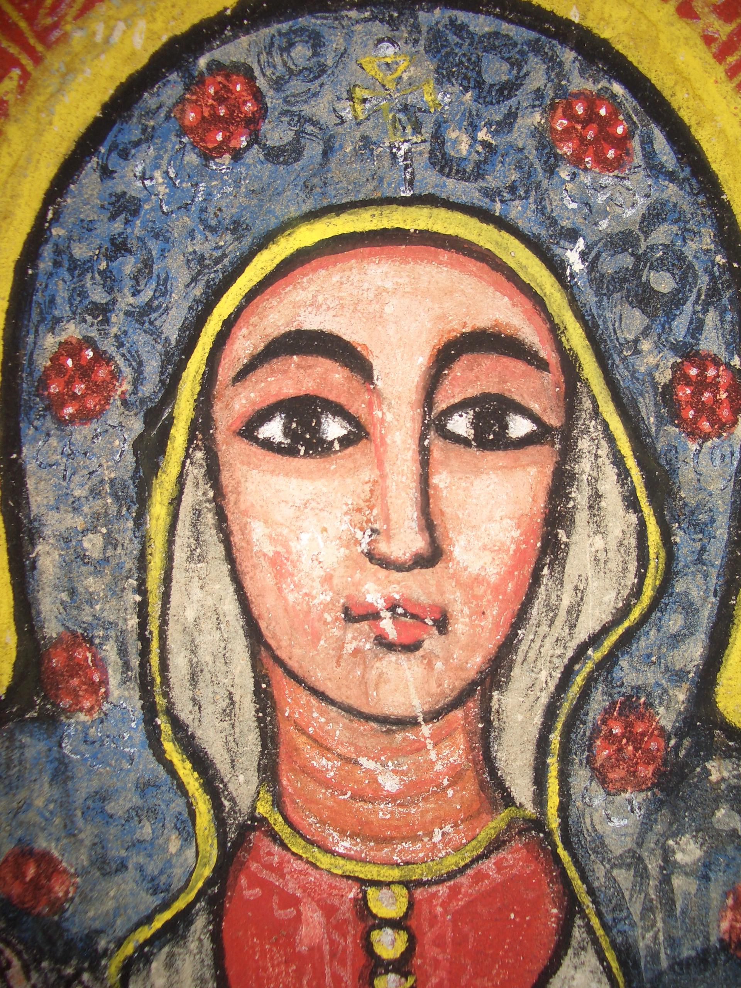
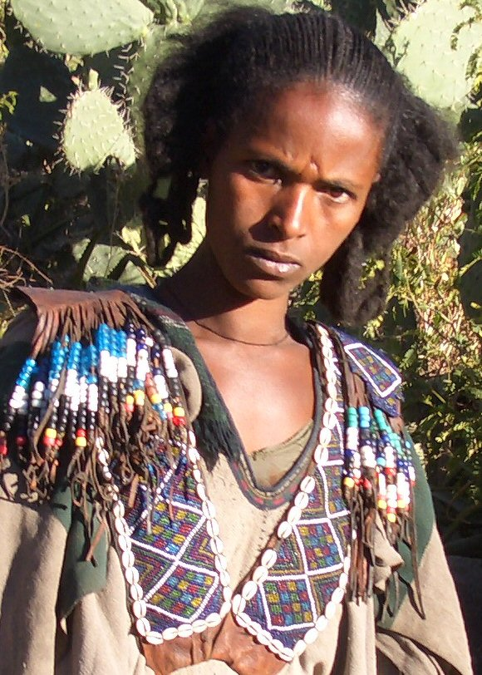
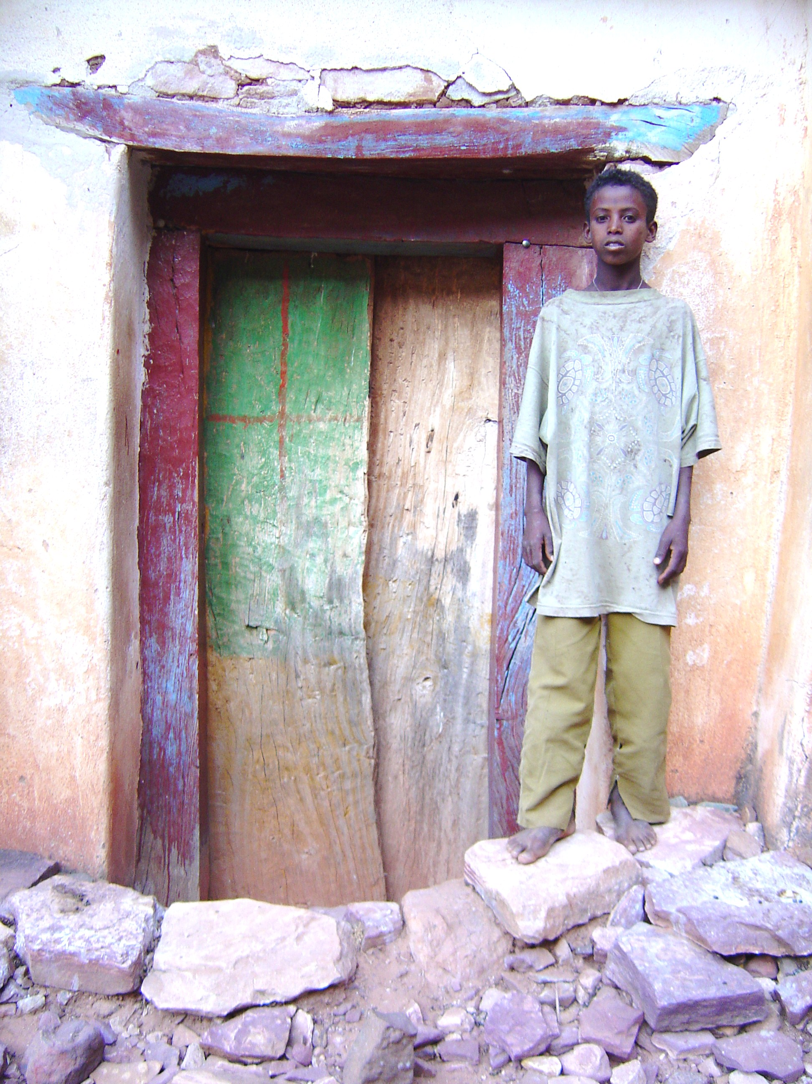
Virtual Visit to Ethiopia
Presentation and slide show by Halina Walatek McKenney
MPR – Friday, March 11 – 6pm
Why are you younger in Ethiopia?
What do some Ethiopian men wear on their heads?
What item is supplied free in Ethiopian hotels -- but isn't available in American ones?
What does King Solomon have to do with Ethiopia?
Why it makes sense to call arid Ethiopia the "Country of One Thousand Islands?”
Find out to the answers to these questions and more!
You will also see unique pictures from remote areas of Ethiopia which are seldom seen by foreigners...
and you will get an opportunity to try original Ethiopian food!

